Slide 1
IBM University Engagement Project Submission
“Exploring the Power of Agentic AI with IBM Granite and IBM Bob”

Slide 2

Project Tile – Social Media Agent
Domain of Project – Social Media Analytics
Student Name | Recent Passport Photo | Email ID | Mobile number [WhatsApp]
Mamatha R |  | mamatharmanjunath@gmail.com | 9663975656

Slide 3
Problem Statement - Social Media Agent
The Challenge
Brands, influencers, and organizations struggle to keep up with the fast-paced and fragmented world of social media. Content trends evolve hourly, audience sentiment shifts rapidly, and competitor strategies are difficult to track. Managing multiple platforms often leads to scattered insights, missed engagement opportunities, and ineffective campaigns. The challenge is not only to collect social media data but also to analyze, predict, and recommend actions in real time.
The Objective
Build an agentic AI application that acts as an intelligent social media companion. The solution should:
1. Fuse Multichannel Data :- Collect and synthesize content, comments, hashtags, and competitor posts from platforms like X, LinkedIn, Instagram, and Facebook into unified insights.
2. Enable Multimodal Interaction :- Accept user inputs (text, images, or voice prompts) and generate creative post drafts, captions, or campaign ideas aligned with brand tone.
3. Create a Predictive & Agentic Layer :- Forecast trending hashtags, audience sentiment shifts, and competitor engagement patterns while suggesting the best posting schedules.
4. Visualize Social Media Pulse :- Provide a dashboard with real-time analytics—engagement trends, influencer mapping, sentiment tracking, and campaign performance forecasts.

Slide 4
Proposed Solution -
AI-Powered Social Media Agent
Collects posts, comments, hashtags, and competitor data from X, LinkedIn, Instagram, and Facebook.
Generates AI-powered posts, captions, and campaign ideas using text, image, or voice inputs.
Analyzes audience sentiment and engagement in real time.
Predicts trending hashtags, best posting times, and campaign performance.
Monitors competitor strategies and engagement patterns.
Visualizes insights through an interactive analytics dashboard.
Built using: IBM Bob, IBM Granite Models, IBM watsonx.ai, IBM Cloud, RAG, and Vector Database.

Slide 5
Proposed Solution -
AI-Powered Social Media Agent
Collects posts, comments, hashtags, and competitor data from X, LinkedIn, Instagram, and Facebook.
Generates AI-powered posts, captions, and campaign ideas using text, image, or voice inputs.
Analyzes audience sentiment and engagement in real time.
Predicts trending hashtags, best posting times, and campaign performance.
Monitors competitor strategies and engagement patterns.
Visualizes insights through an interactive analytics dashboard.
Built using: IBM Bob, IBM Granite Models, IBM watsonx.ai, IBM Cloud, RAG, and Vector Database.
Multi-Agent Workflow
Content Generation Agent – Creates posts, captions, and campaign ideas.
Trend Analysis Agent – Identifies trending topics and hashtags.
Sentiment Analysis Agent – Detects audience opinions and emotions.
Competitor Analysis Agent – Tracks competitor content and engagement.
Recommendation Agent – Suggests the best posting time and platform.

Slide 6
Technology Used
IBM Bob
Designs and orchestrates multi-agent workflows.
IBM Granite Models
Generates content, reasoning, and predictions.
IBM watsonx.ai
Deploys AI models and manages prompts & governance.
IBM Cloud
Provides secure and scalable cloud infrastructure.
RAG (Retrieval-Augmented Generation)
Retrieves real-time social media trends and insights.

Slide 7
Technology Used
Vector Database (FAISS/Chroma)
Stores embeddings for fast semantic search and retrieval.
Social Media APIs
Collects data from X, LinkedIn, Instagram, and Facebook.
Analytics Dashboard (Streamlit/React)
Visualizes engagement, sentiment, trends, and campaign performance.

Slide 8
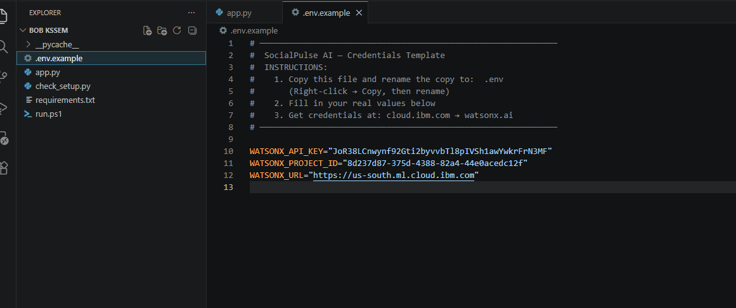
Required Files created using IBM bob -
App.py
Requirements.txt
Style.css
.env
Index.html

Slide 9
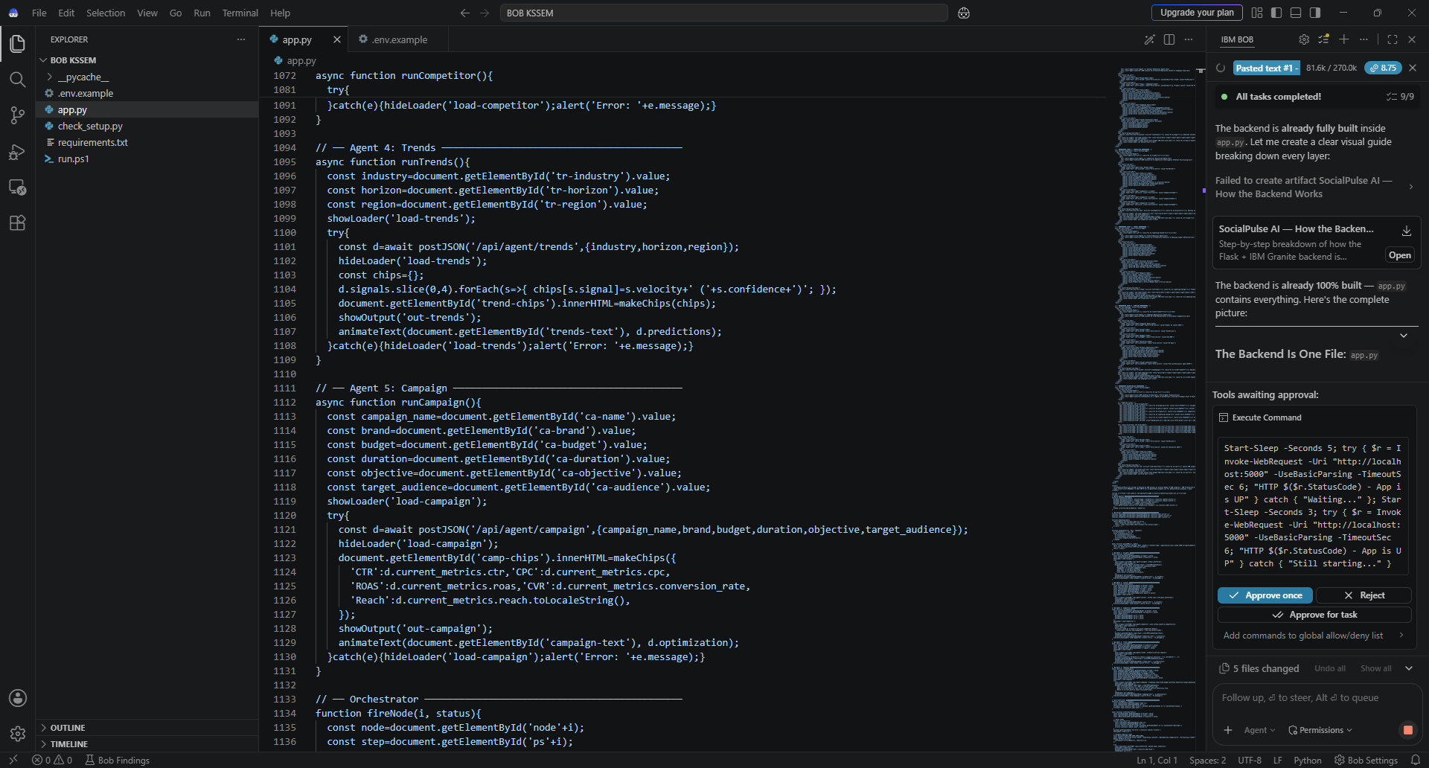
IBM Bob Screenshots:

Slide 10
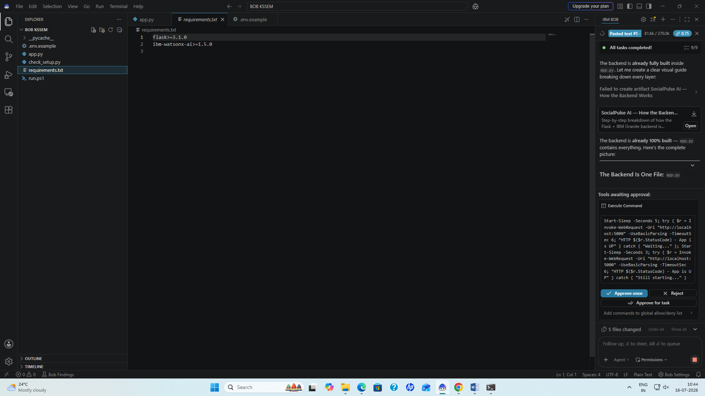

Slide 11

Role of Agentic AI in the solution
Role of Agentic AI in Social Media Agent
Agentic AI enables the Social Media Agent to function as an autonomous digital marketing assistant rather than a traditional chatbot.
Each specialized agent performs an independent task while collaborating with other agents.
The agents
Collect live social media data
Generate creative content
Analyze customer sentiment
Track competitors
Predict trending hashtags
Recommend posting schedules
Agentic AI continuously learns from changing trends and adapts recommendations in real time, enabling businesses to improve engagement and marketing performance.

Slide 12
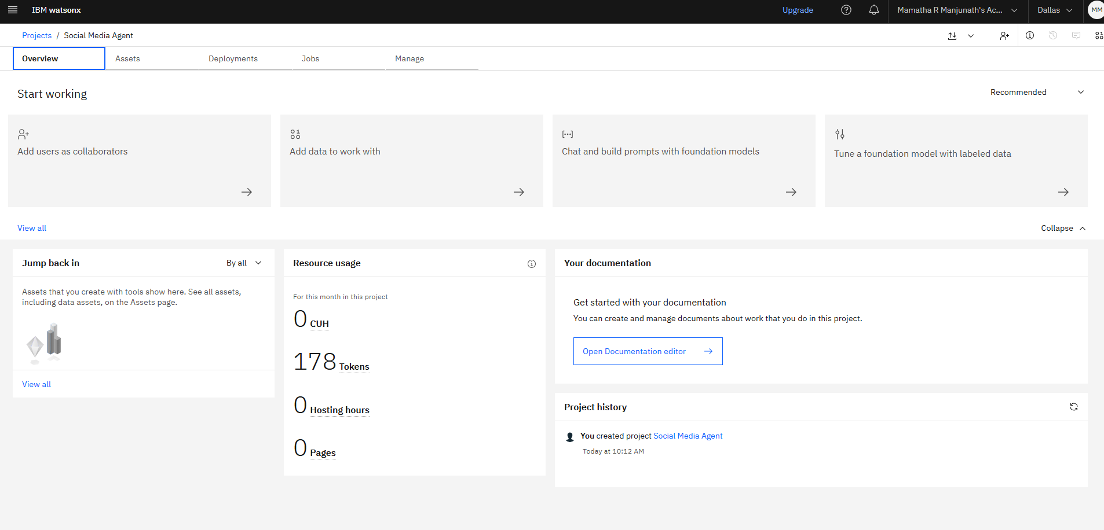
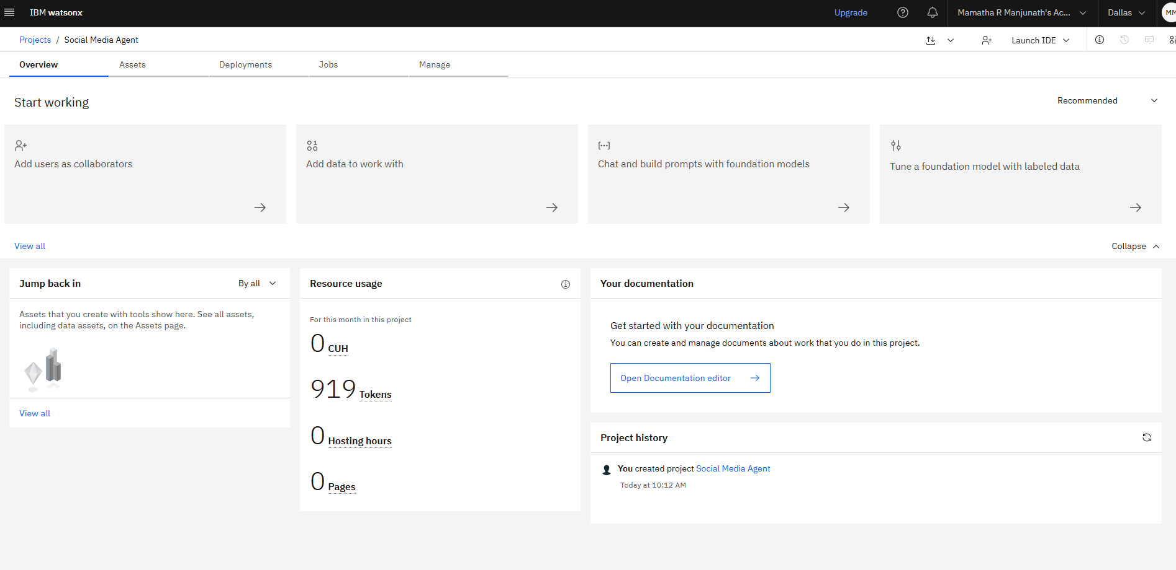
Token Usage
919 tokens are used
Before Prompt After Prompt

Slide 13
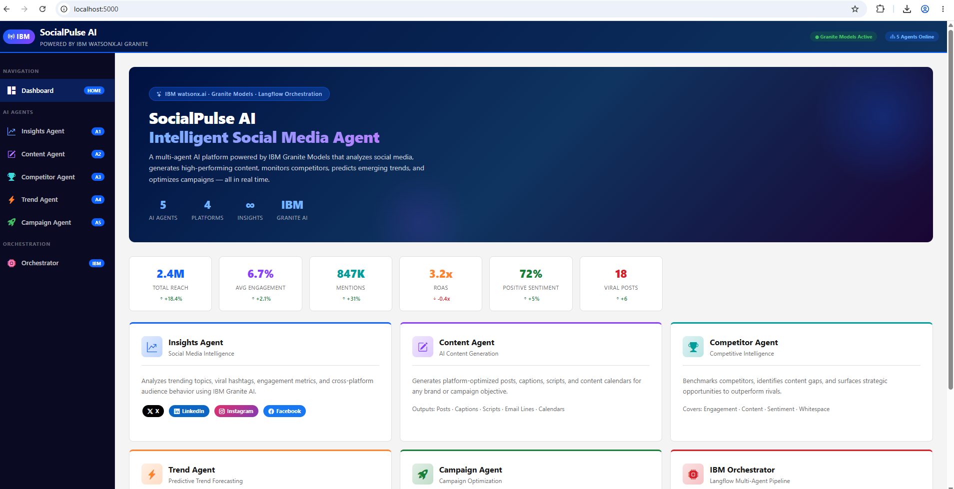
Project Output Screenshot
Please put IBM Bob output screenshots with 2-3 prompts.
You can take 2-3 more slides for each screenshot
·
·
·

Slide 14
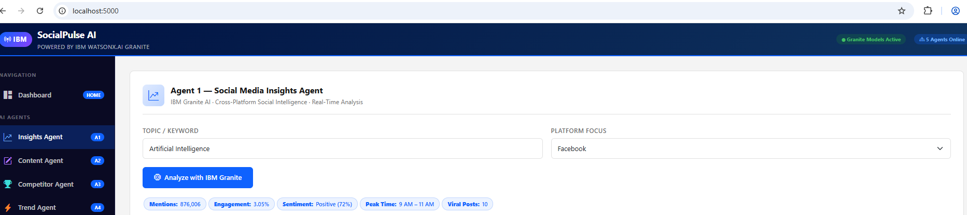
Project Output Screenshot
Please put IBM Bob output screenshots with 2-3 prompts.
You can take 2-3 more slides for each screenshot
·
·
·

Slide 15
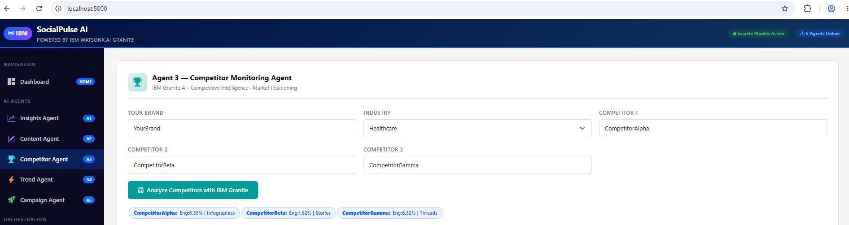
Project Output Screenshot
Please put IBM Bob output screenshots with 2-3 prompts.
You can take 2-3 more slides for each screenshot
·
·
·

Slide 16
Novelty and Uniqueness
Multi-Agent AI – Specialized agents collaborate to automate social media tasks.
Cross-Platform Analysis – Collects insights from X, LinkedIn, Instagram, and Facebook.
Predictive Analytics – Forecasts trending hashtags and audience engagement.
Sentiment Intelligence – Tracks customer opinions in real time.
Multimodal Support – Accepts text, image, and voice inputs.
Competitor Monitoring – Analyzes competitor strategies and performance.
Smart Recommendations – Suggests the best posting time and content strategy.
Interactive Dashboard – Displays real-time analytics and campaign performance.
"An intelligent AI companion that transforms social media management through automation, prediction, and real-time insights."

Slide 17
Git Hub Link
https://github.com/mamatharamesh1623/Social_Media_Agent
·
·
·

Slide 18
Future Scope
1. AI Video & Reel Generation
Automatically create promotional videos and reels.
2. Influencer Collaboration
Recommend influencers based on audience demographics.
3. Marketing ROI Prediction
Predict campaign success before publishing.
4. Multilingual Content Generation
Generate posts in multiple languages.
5. Automatic Campaign Optimization
Continuously improve campaigns based on engagement analytics.

Slide 19
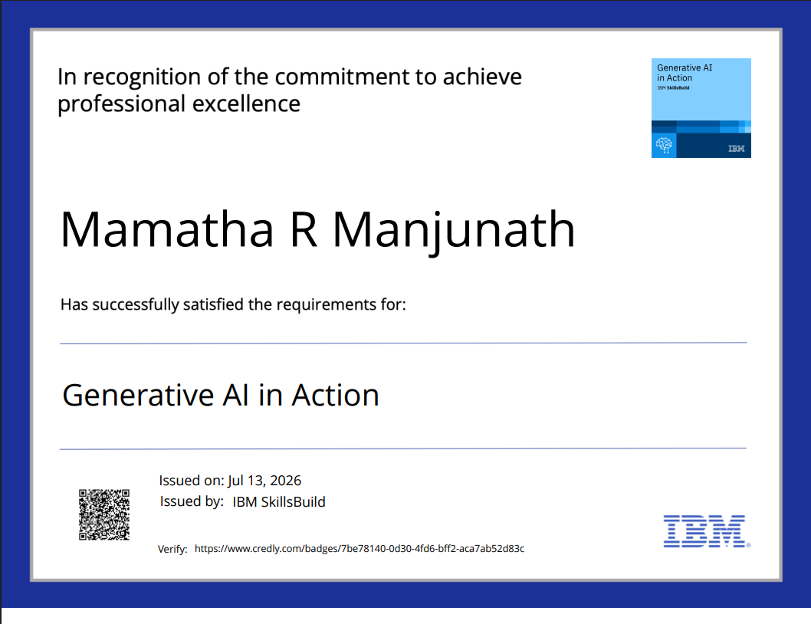
Certificates Earned:
Please add your credly certificate

Slide 20
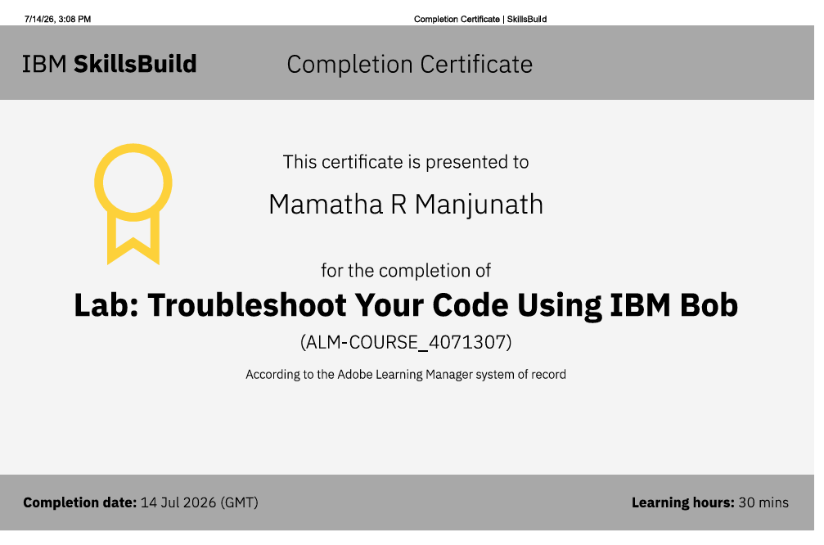
Certificates Earned:​
Add your IBM BOB Certificate

Slide 21


